Slide 1

Web Applications (URL's Monitoring

Slide 2
Urls' Monitoring:
We need to check whether Web URL's are working fine or not.
As soon as we connect to the shift, we should open the links and keep on monitoring.

Slide 3
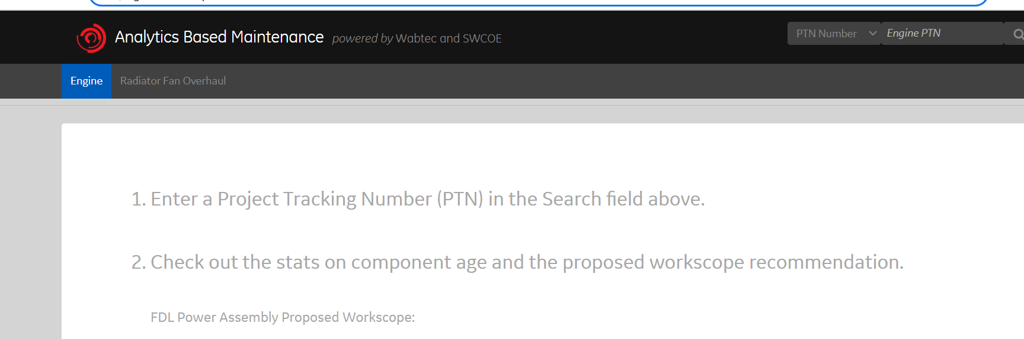
ABM Prod URL:
https://engineabm.corp.wabtec.com/GTABM/

Slide 4
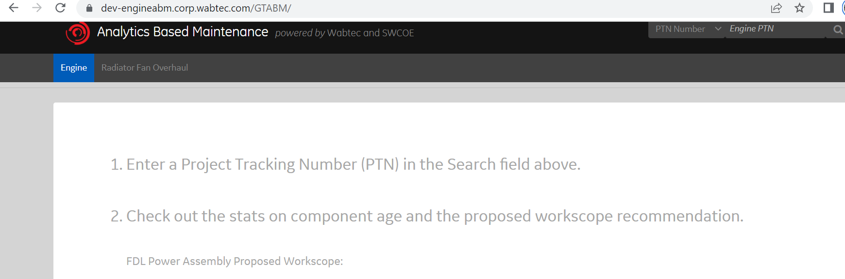
ABM Dev URL:
https://dev-engineabm.corp.wabtec.com/GTABM/

Slide 5
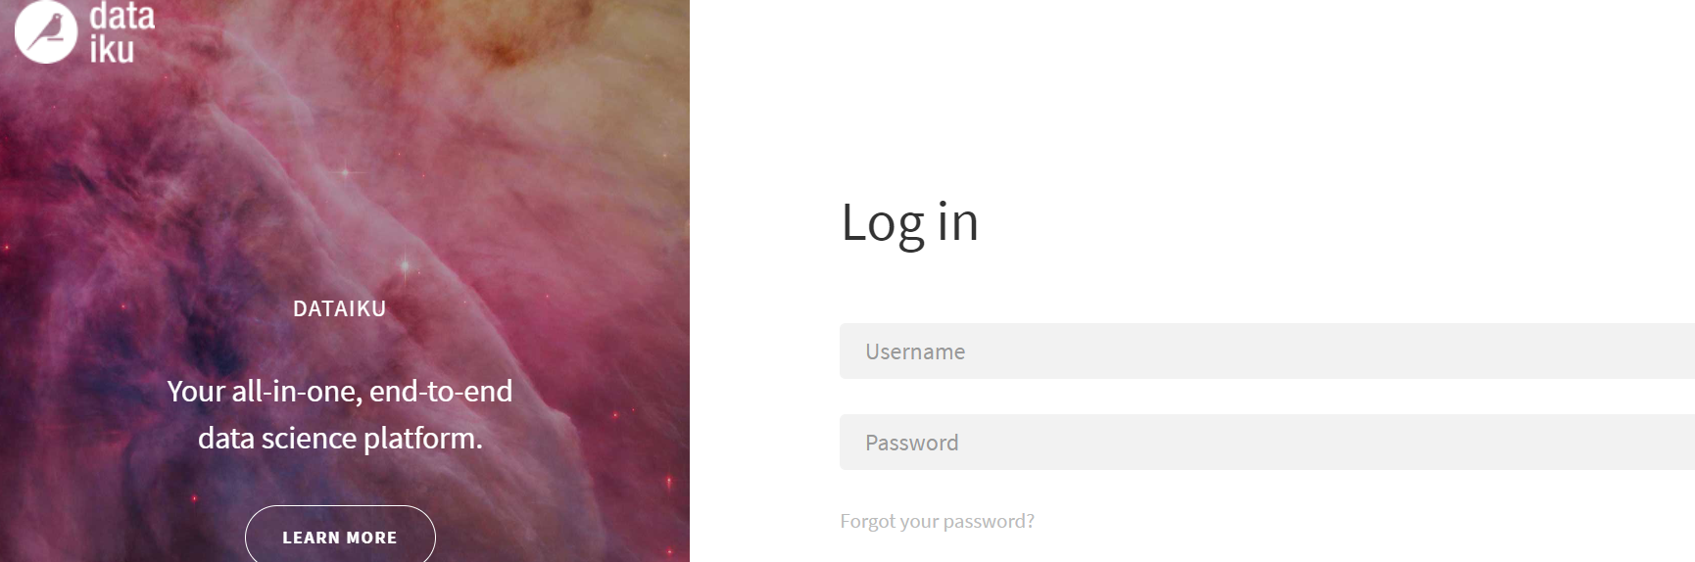
Dataiku Prod Automation URL:
https://auto.dataiku.corp.wabtec.com/login/?redirectTo=~2F
Note: We don't have Dev environment for Dataiku Automation

Slide 6
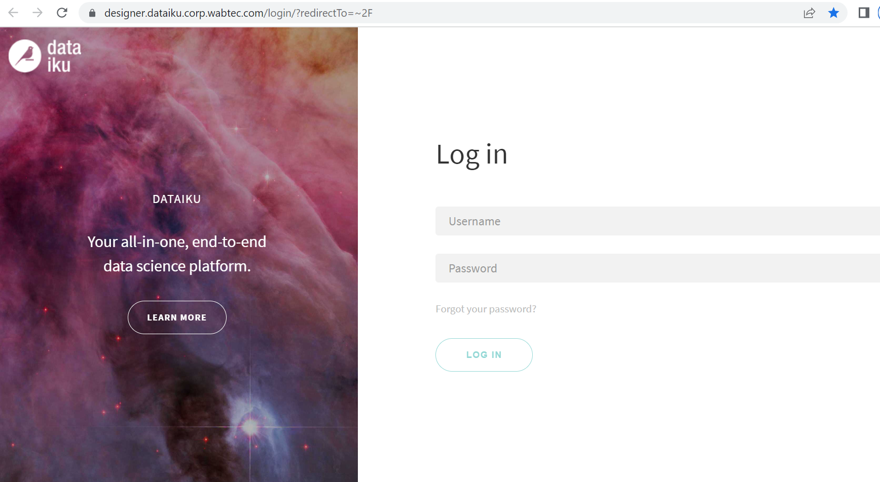
Dataiku Designer Prod Url:
https://designer.dataiku.corp.wabtec.com/login/?redirectTo=~2F

Slide 7
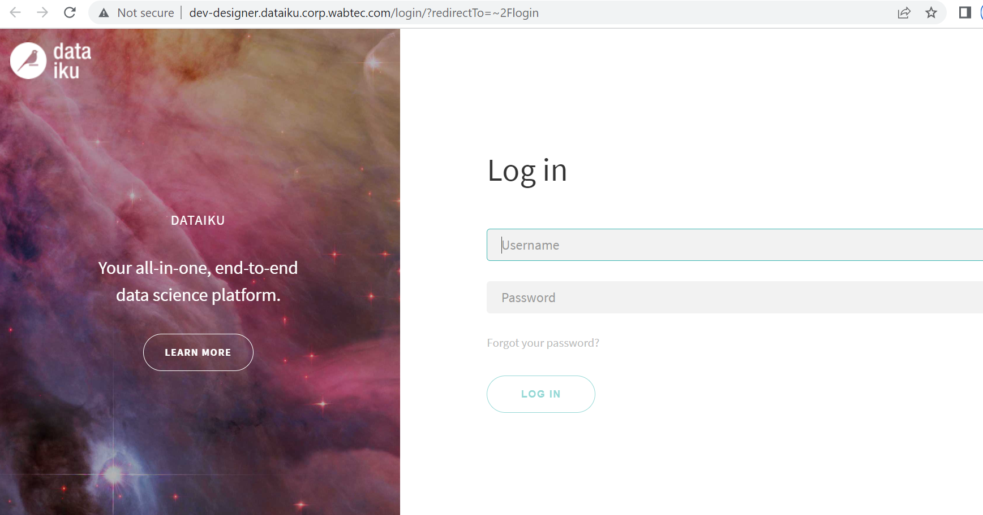
Dataiku Designer Dev Url:
https://designer.dataiku.corp.wabtec.com/login/?redirectTo=~2F

Slide 8
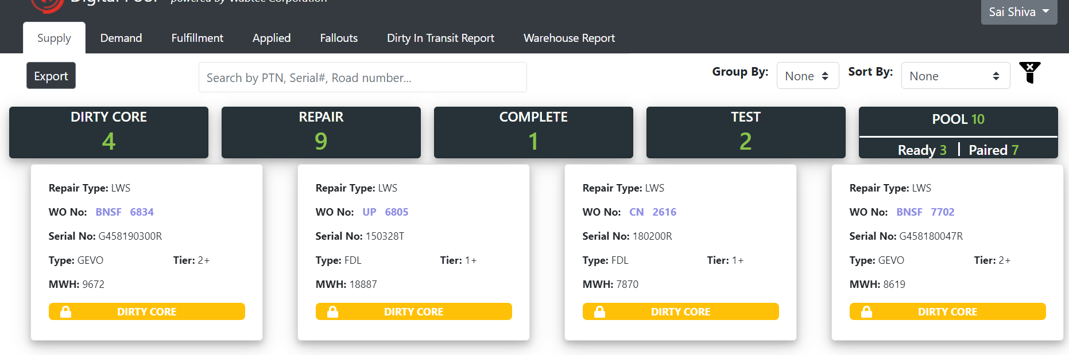
DigitalPool Prod URL:
https://digitalpool.corp.wabtec.com/#/dashboard

Slide 9
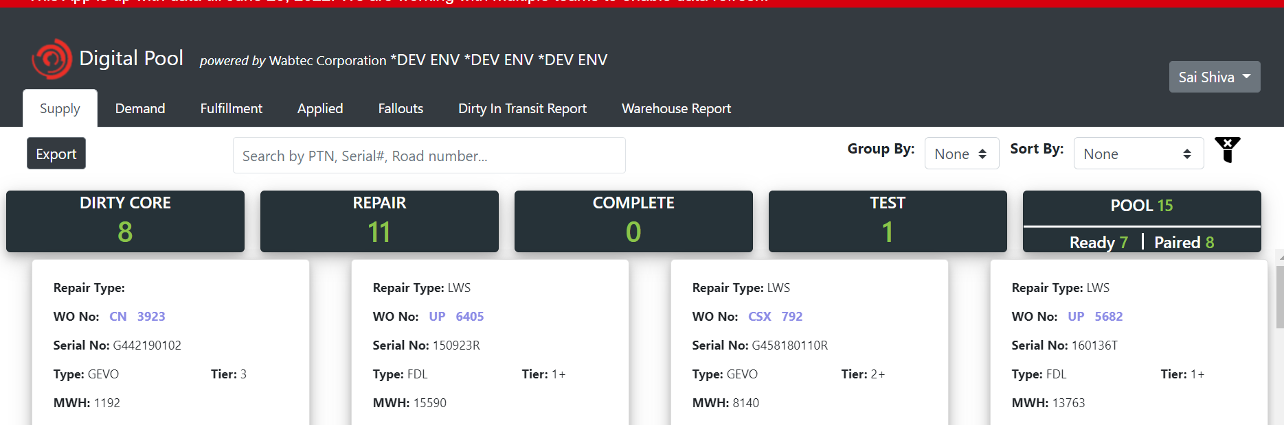
DigitalPool Dev URL:
https://dev-digitalpool.corp.wabtec.com/#/dashboard

Slide 10
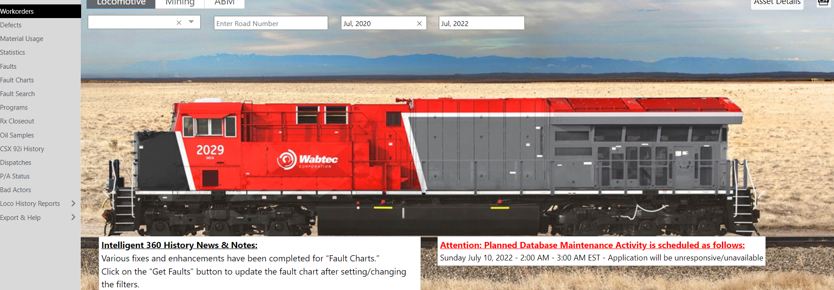
I360 Prod URL:
https://i360history.corp.wabtec.com/i360history/#/Content/Workorder

Slide 11
I360 Dev URL:
https://dev-i360history.corp.wabtec.com/i360history/#/Content/Workorder

Slide 12
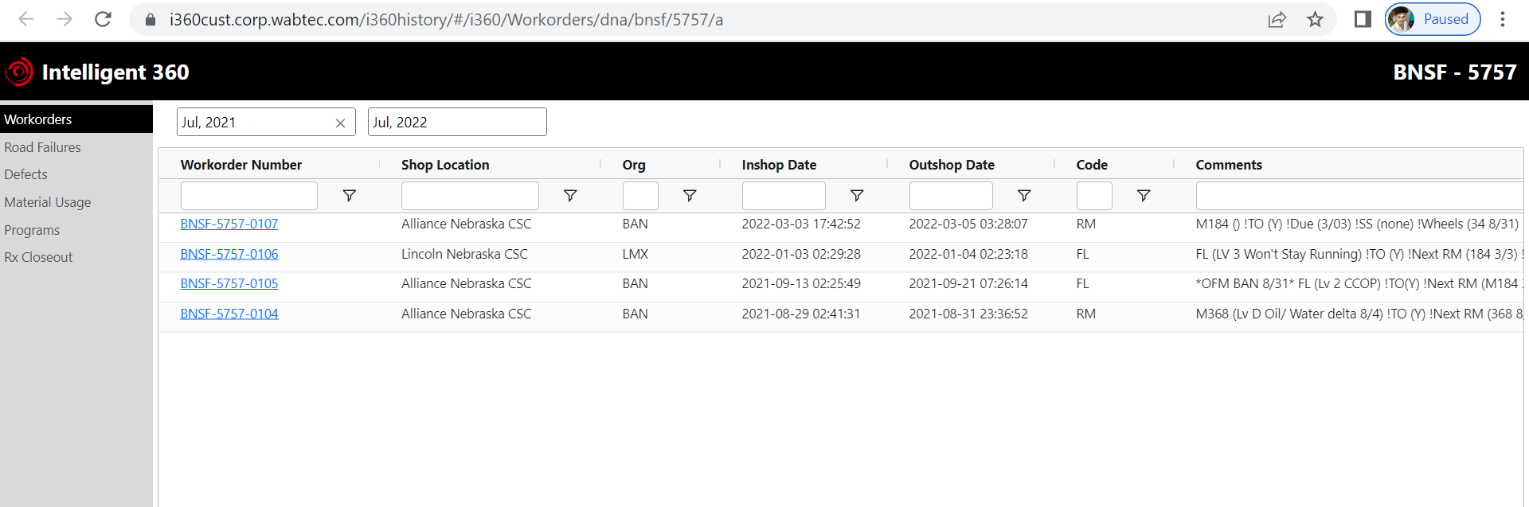
I360 Cust Prod URL:
https://i360cust.corp.wabtec.com/i360history/#/i360/Workorders/dna/bnsf/5757/a

Slide 13
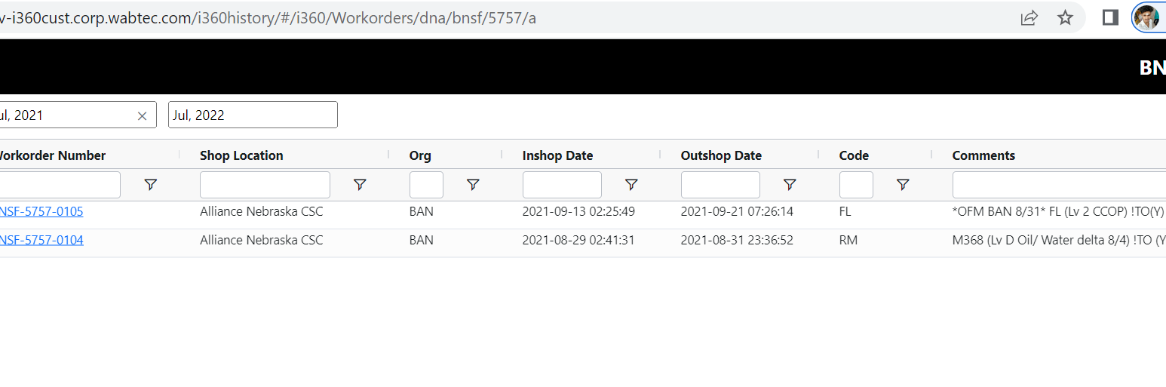
I360 Cust Dev URL:
https://dev-i360cust.corp.wabtec.com/i360history/#/i360/Workorders/dna/bnsf/5757/a

Slide 14
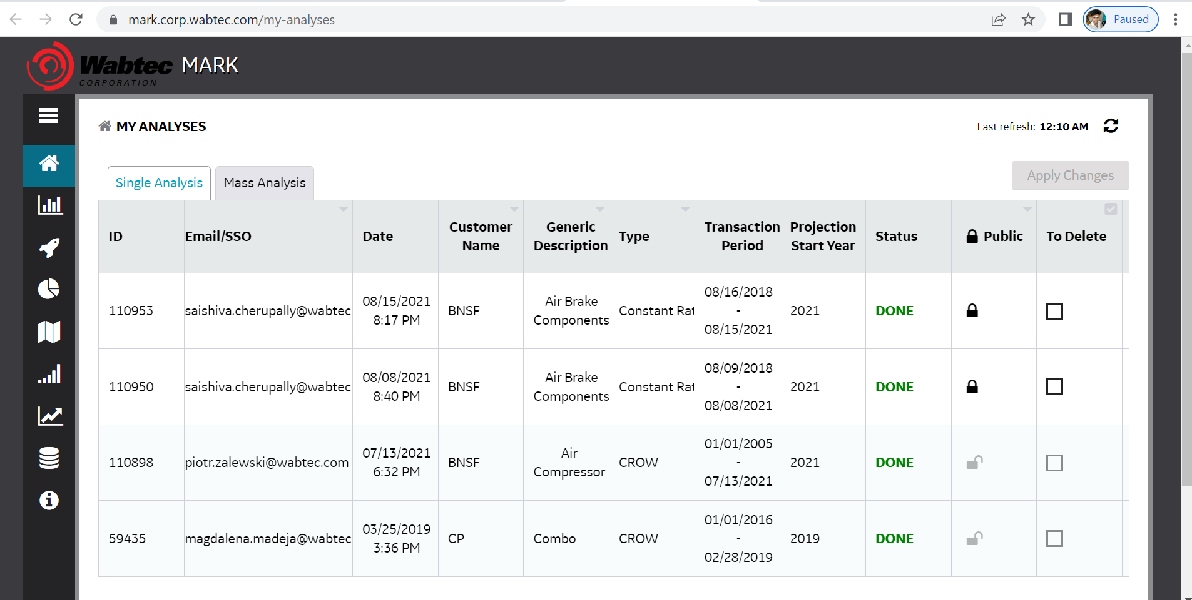
Mark Prod URL:
https://mark.corp.wabtec.com/my-analyses

Slide 15
Mark Dev URL:
https://dev-mark.corp.wabtec.com/my-analyses

Slide 16
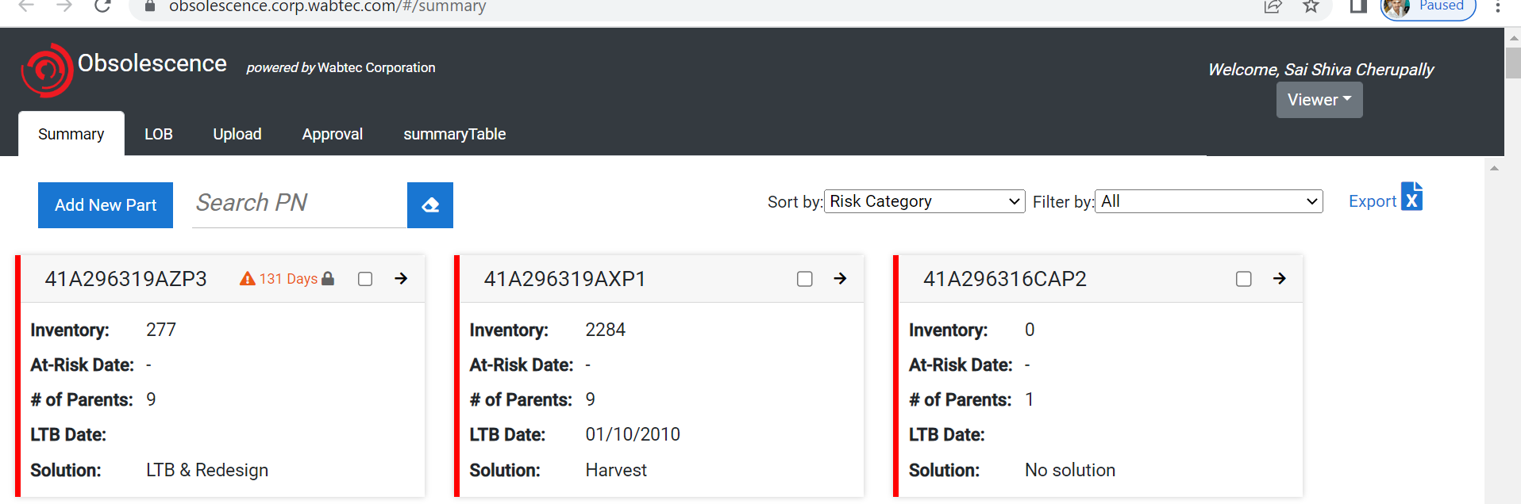
Obsolescence Prod URL:
https://obsolescence.corp.wabtec.com/#/summary

Slide 17
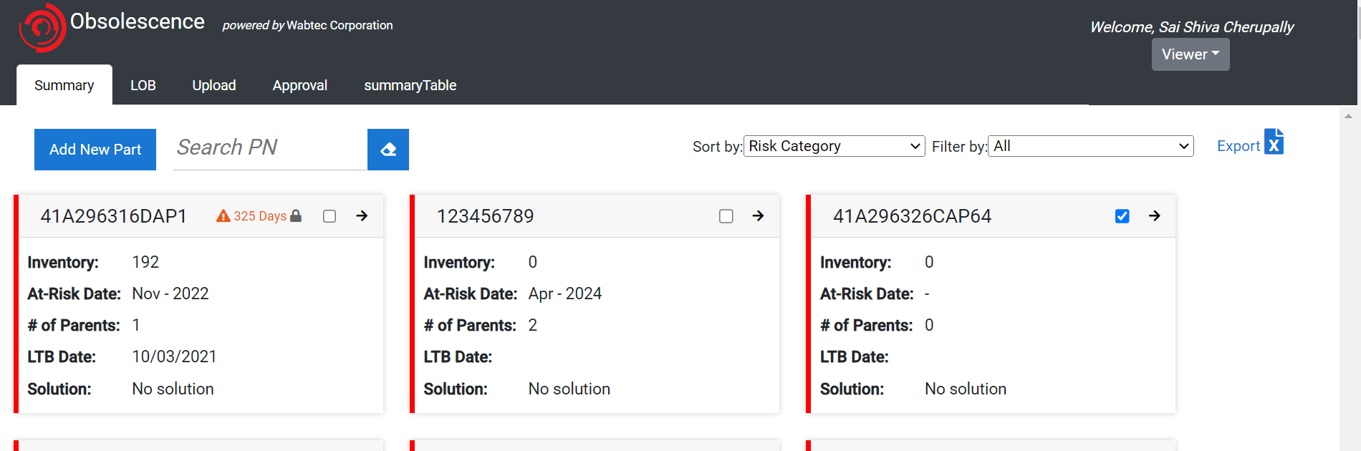
Obsolescence Dev URL:
https://dev-obsolescence.corp.wabtec.com/#/summary

Slide 18
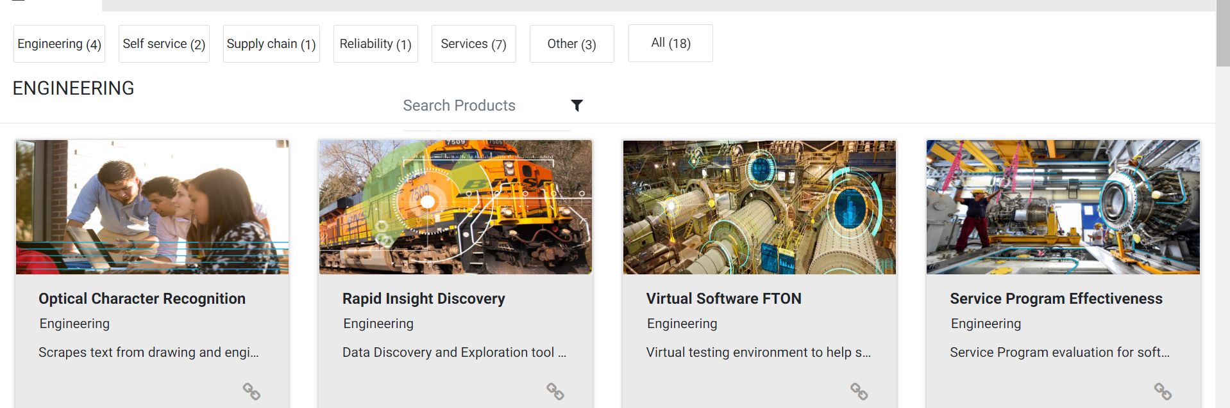
Product Catalog Prod URL:
https://productcatalog.corp.wabtec.com/products
Note: We don't have access for dev environment
URL: https://dev-productcatalog.corp.wabtec.com/products

Slide 19
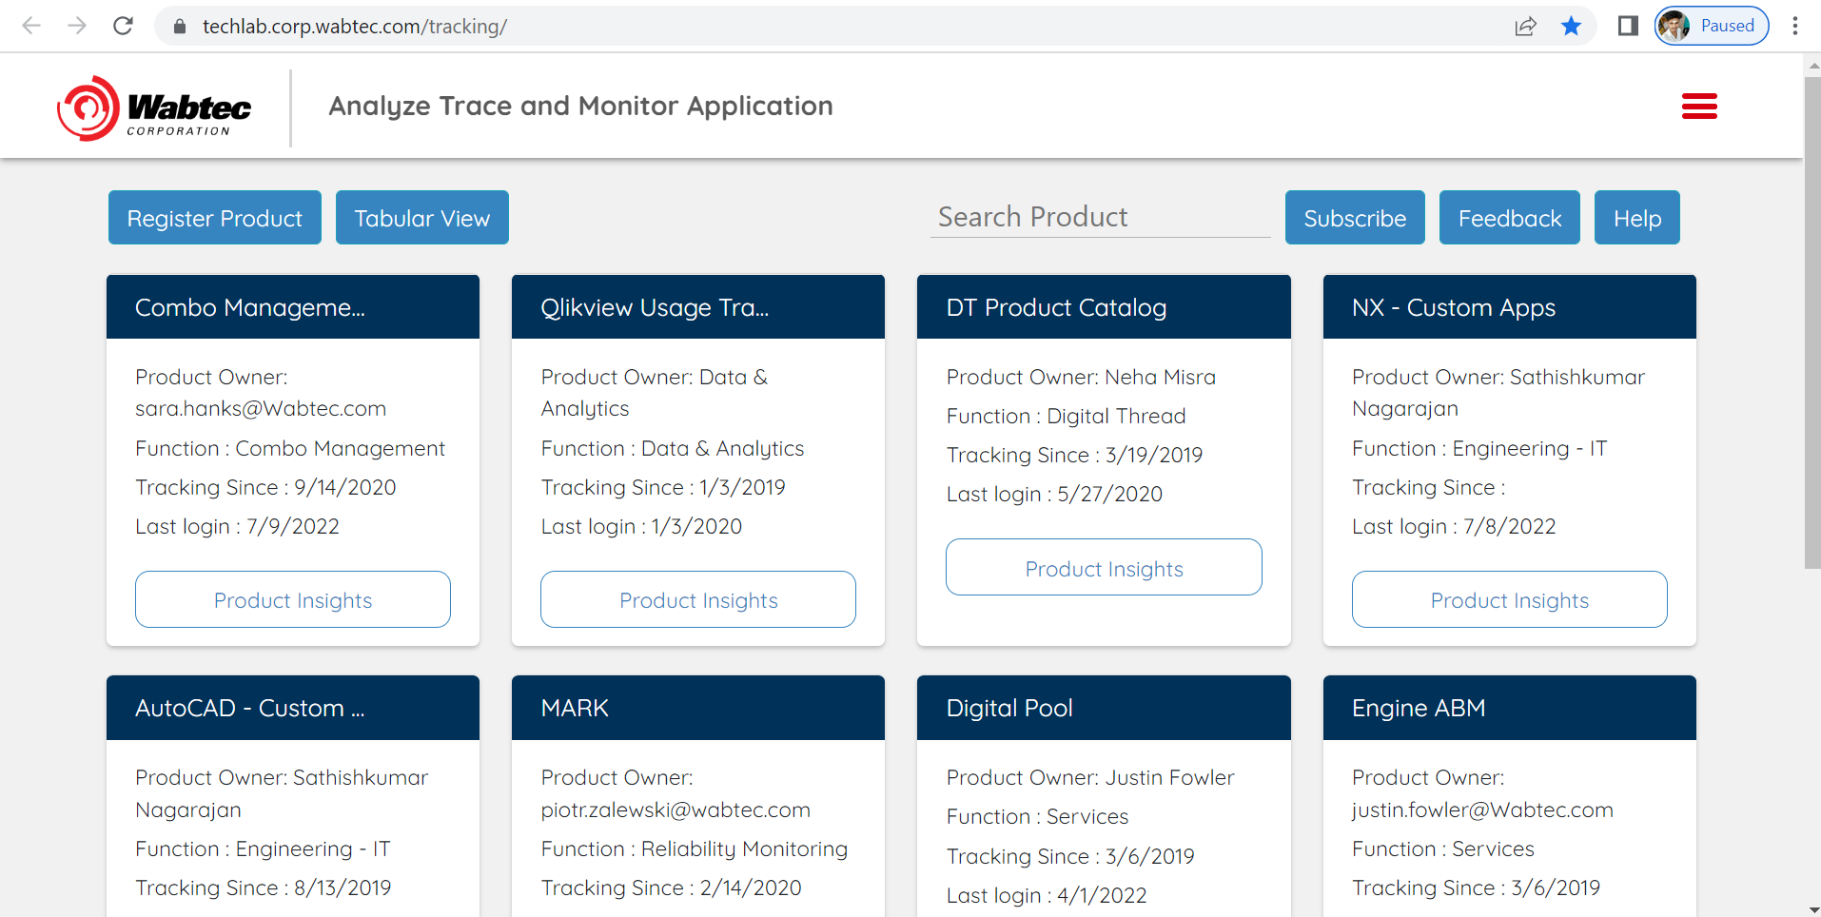
Techlab Prod Url:
https://techlab.corp.wabtec.com/tracking/

Slide 20
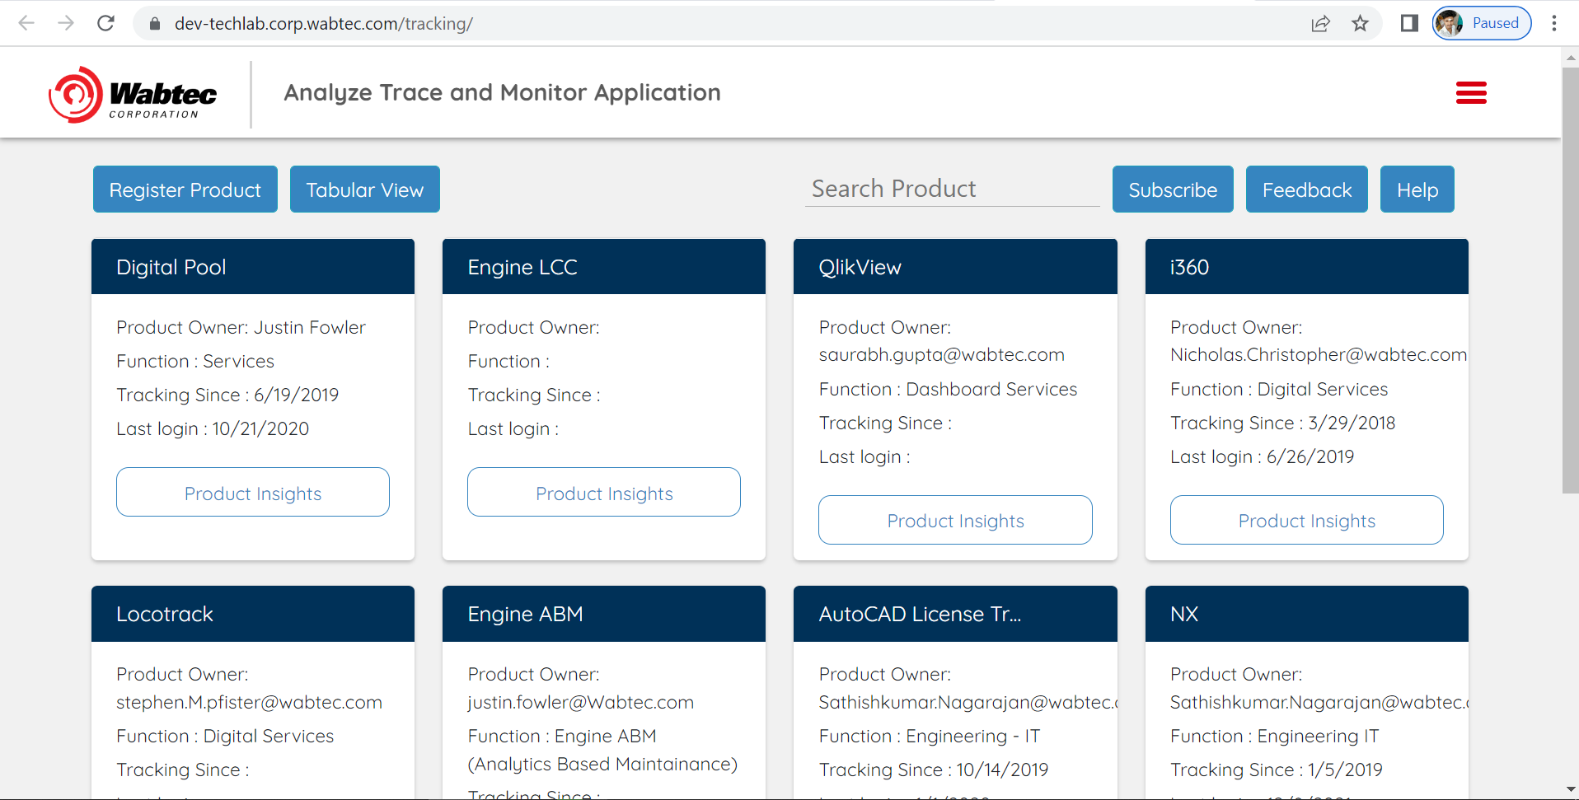
Techlab Dev Url:
https://dev-techlab.corp.wabtec.com/tracking/

Slide 21
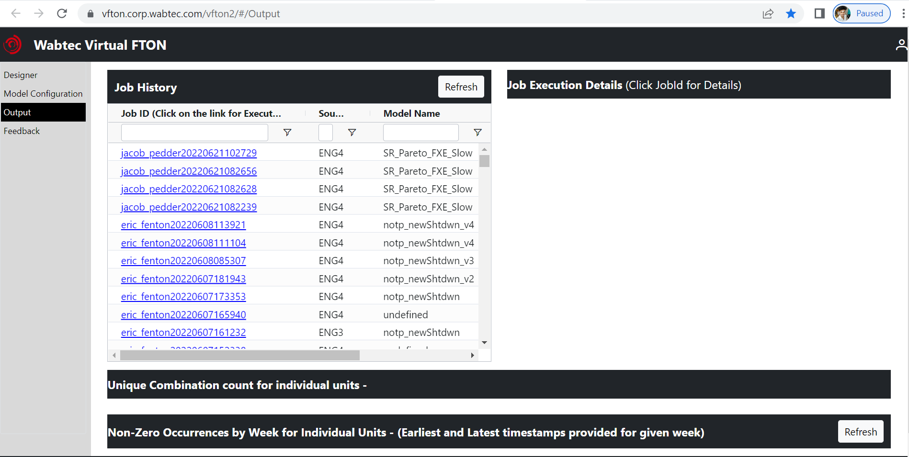
Vfton Prod Url:
https://vfton.corp.wabtec.com/vfton2/#/Output

Slide 22
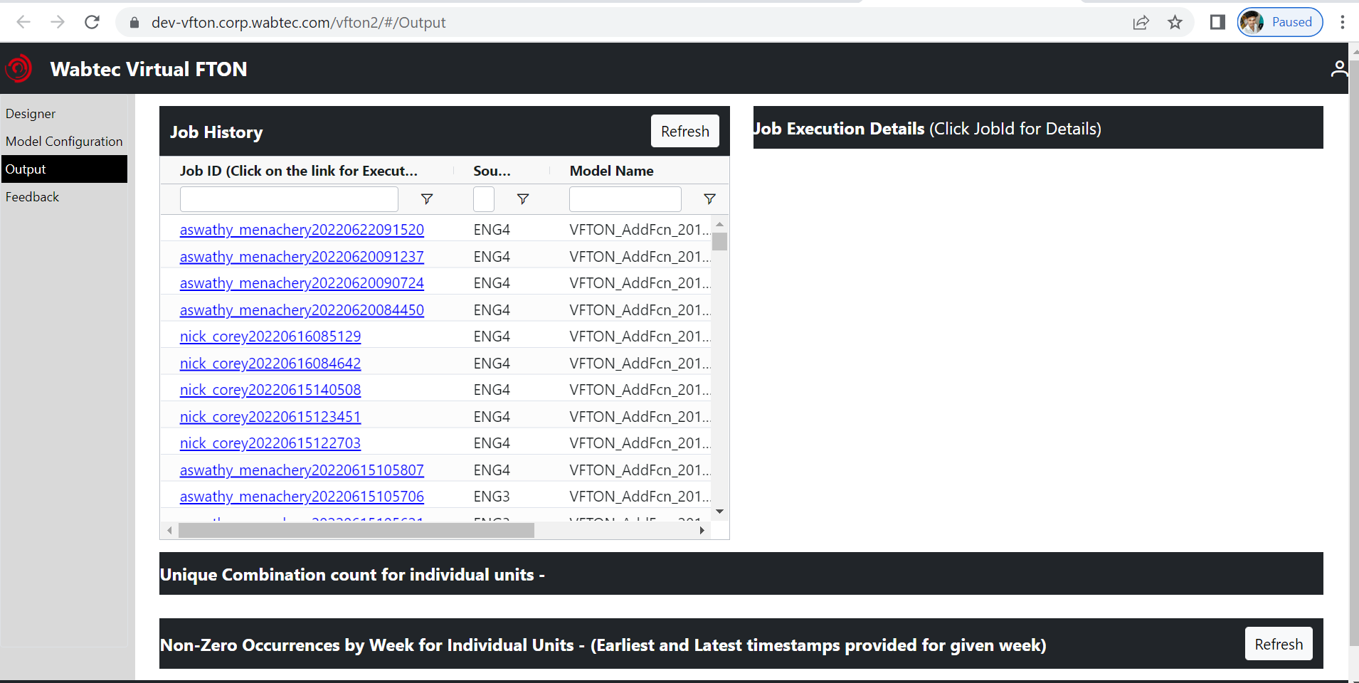
Vfton Dev Url:
https://vfton.corp.wabtec.com/vfton2/#/Output

Slide 23
Thank you

